Slide 1
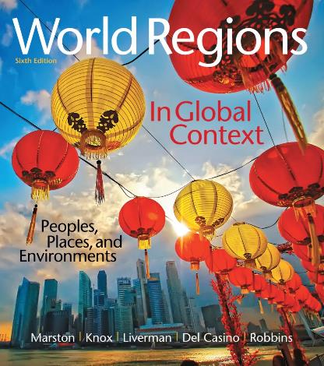
World Regions in Global Context:
Peoples, Places, and Environments
6th Edition
Sub-Saharan Africa
Lectures by:
Christa Ann Smith

Slide 2
Learning Outcomes
Compare the physical geographies of the diverse regions of sub-Saharan Africa, contrasting the climate and vegetation of the Sahel and the Congo Basin, the East African Rift Valley and Okavango, and the major rivers.
Evaluate the role of physical geography, disease, and mineral resources in shaping conflicts, crises, landscapes, and economies.
Identify the impacts of human activity on African wildlife and climates and some of the solutions to these threats.
Summarize the legacies of European colonialism and the Cold War in the region and how these, together with the diversity of ethnicities, religions, and languages, have created conflict within and between countries.

Slide 3
Learning Outcomes
Explain how debt relief, the end of several conflicts, and improving the status of women may increase the chance of positive economic and political futures in sub-Saharan Africa.
Describe the main causes of low agricultural production in sub-Saharan Africa, connections of agriculture to desertification and deforestation, and problems that are emerging around land grabs.
Analyze factors affecting the characteristics of populations in sub-Saharan Africa, including the demographic transition, HIV/AIDS and other diseases, urbanization, fertility changes, and migration.
Provide examples of how African people, goods, and culture have spread around the world as a result of slavery, colonialism, and globalization.

Slide 4
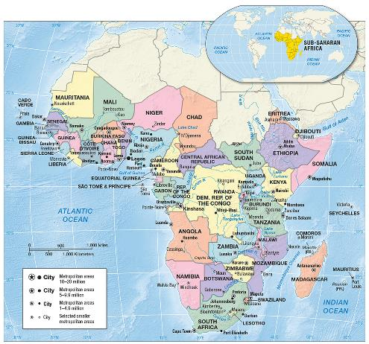
Sub-Saharan Africa
Some of fastest growing economies in the world
Peace achieved in many regions
Health indicators starting to improve

Slide 5
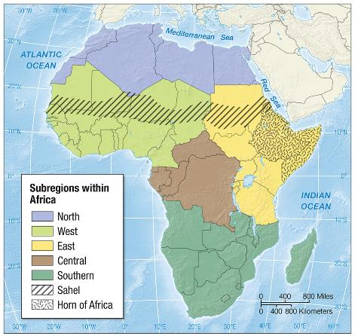
Environment, Society, and Sustainability
Large, complex continent
Region of Africa south of the Sahara

Slide 6
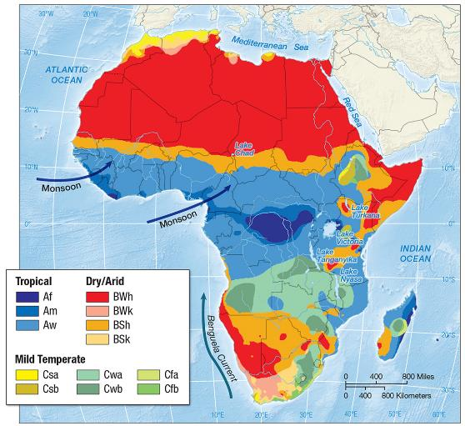
Climate and Climate Change
Intertropical convergence zone (ITCZ)
Subtropical high pressure
Seasonal rainfall

Slide 7
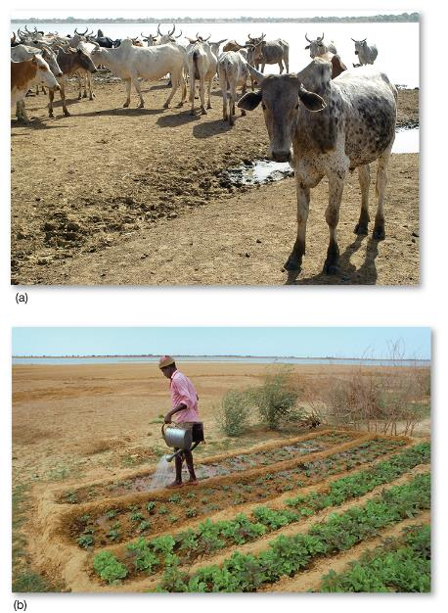
Climate and Climate Change (cont.)
Sahel
  desertification
    pastoralism
    overgrazing
    deforestation
    unskilled irrigation

Slide 8
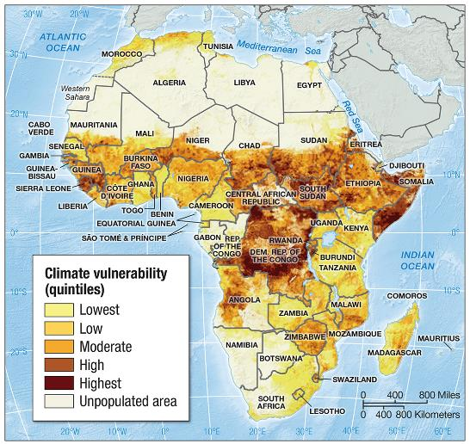
Climate and Climate Change (cont.)
Climate change
  extreme vulnerability
  low greenhouse emissions

Slide 9
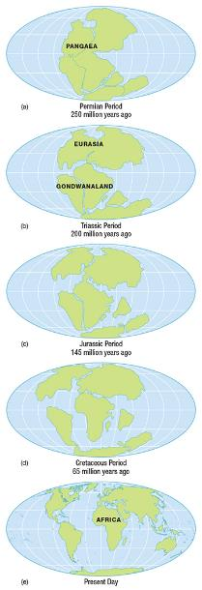
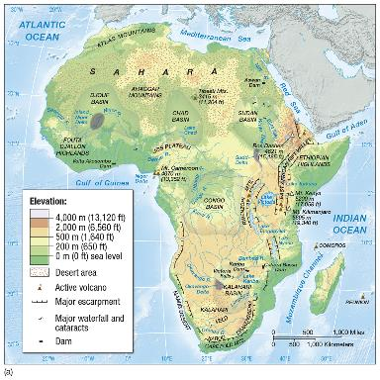
Geological Resources, Risk, and Water
Plate tectonics
  Pangaea
  Gondwanaland
  plateau continent
  rift valley

Slide 10
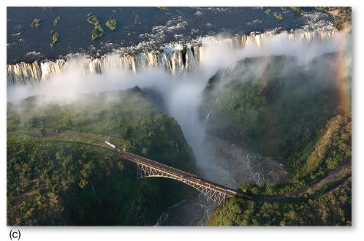
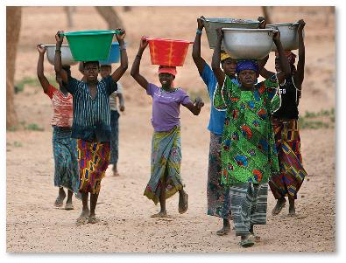
Water Resources and Dams
Water resources
  large river systems
  Sudd
  dam projects
    Kariba
    Akosombo

Slide 11
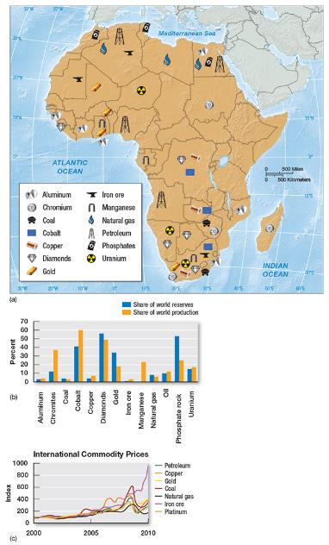
Water Resources and Dams (cont.)
Soils
  not very fertile
    tropical soils
    desert landscapes
Mineral resources
  vast reserves
  assets and liabilities
  gold

Slide 12
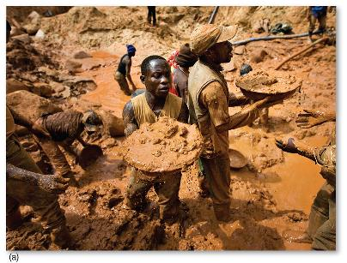
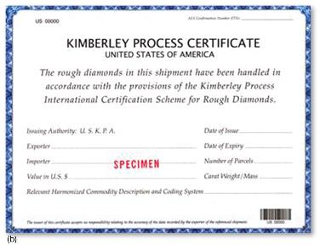
Geographies of Indulgence, Desire, and Addiction
Diamonds
  65% originate in Africa
  De Beers
  conflict diamonds
    Sierra Leone
    Liberia
Kimberley Process

Slide 13
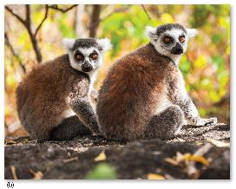
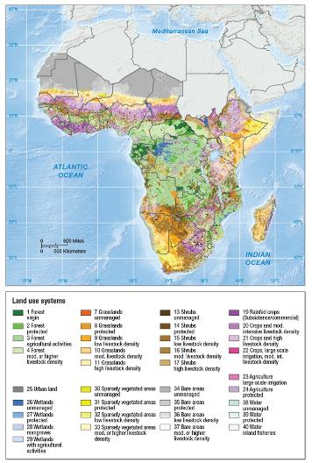
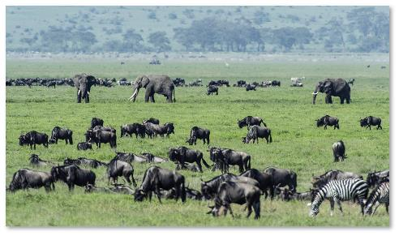
Ecology, Land, and Environmental Management
Ecosystems
  rainforests
  savanna
  deserts
  Madagascar
  deforestation

Slide 14
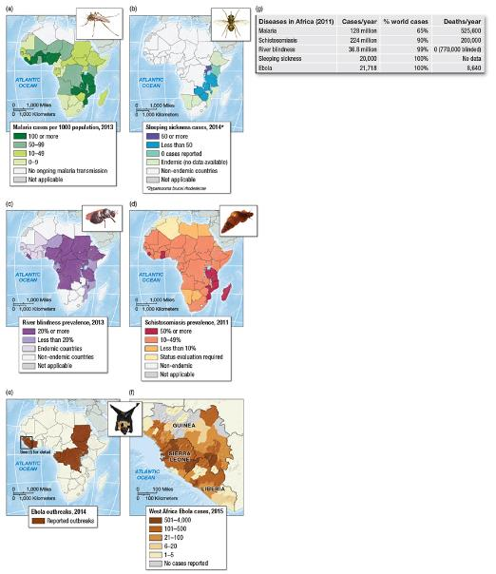
Ecology, Land, and Environmental Management (cont.)
Diseases and pests
  malaria
  schistosomiasis
  river blindness
  World Health
  Organization (WHO)
  tsetse fly

Slide 15
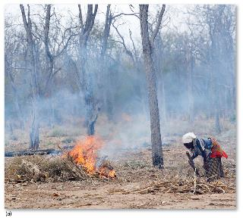
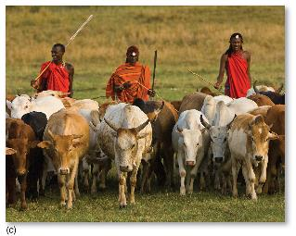
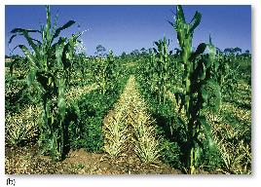
Ecology, Land, and Environmental Management (cont.)
Land use and agriculture
  < 30% of soils good for cultivation
  domestication
  shifting cultivation
    slash-and-burn
    bush fallow
  intercropping
  transhumance

Slide 16
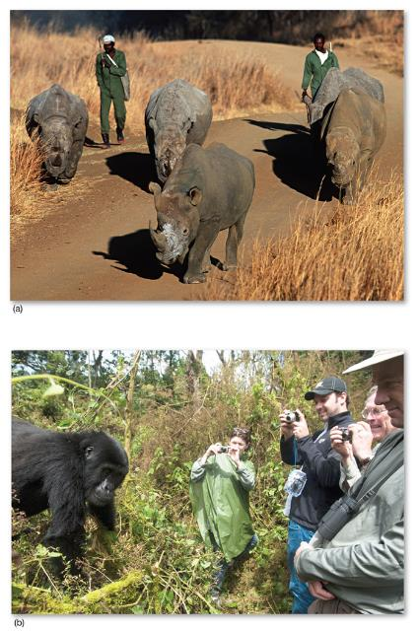
Ecology, Land, and Environmental Management (cont.)
Conservation
  rich biodiversity
  5% of area protected
  criticisms of parks
  bushmeat
  Green Belt Movement

Slide 17
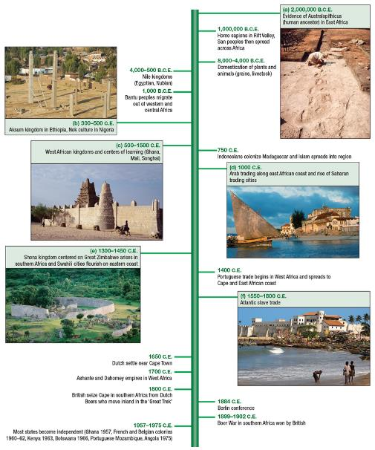
History, Economy, and Territory/Historical Legacies and Landscapes
Human origins
  “cradle of humankind”
Early history
  Aksum
  West African empires
  Zanzibar

Slide 18
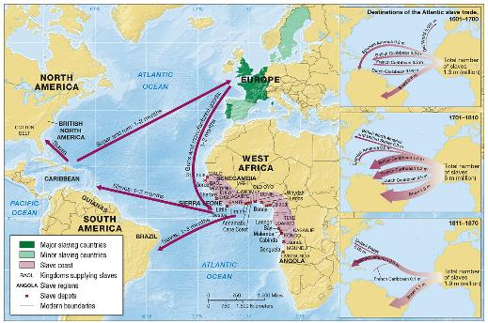
Historical Legacies and Landscapes (cont.)
European settlement
Slave trade
  Southern Africa
    Boers
    Afrikaners
Exploration
  quinine
  Victorian explorers
Scramble for Africa
  Berlin Conference

Slide 19
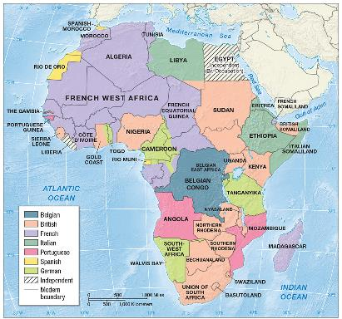
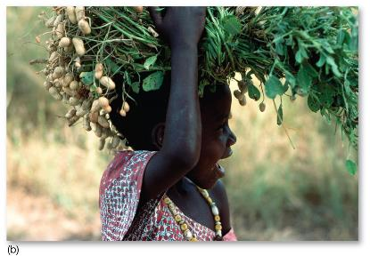
Historical Legacies and Landscapes (cont.)
Colonial legacy
  arbitrary political boundaries
  extraction and export
  introduction of European
  languages
  European colonial policies

Slide 20
Independence
Independence movements
  Transitions
    British
    French
    Belgian
    Portuguese

Slide 21
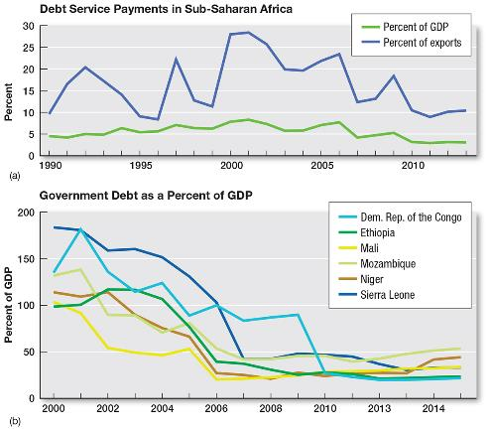
Economy, Debt, and the Production of Inequality
Dependency and debt
  terms of trade
  G8
  import substitution

Slide 22
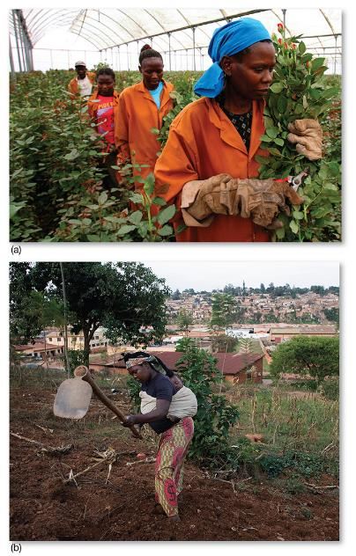
Agricultural Challenges and Opportunities
Yield gaps
Subsistence farming
  Commercial farming
  Land grabs
  Urban agriculture
  Fair trade movement

Slide 23
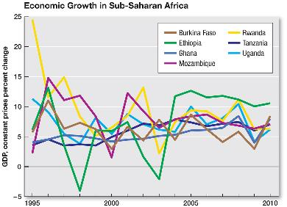
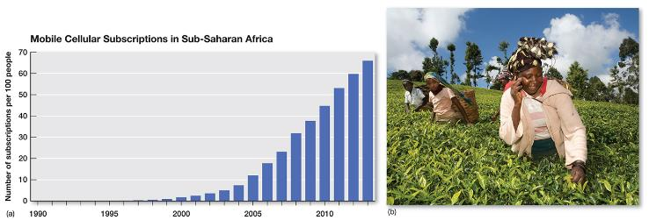
Agricultural Challenges and Opportunities (cont.)
Manufacturing and services
  output doubled in last decade
  microfinance programs
  telecommunications
  informal economy
  remittances
  strong recent economic growth

Slide 24
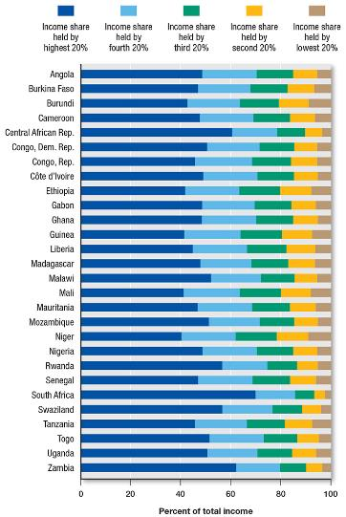
Agricultural Challenges and Opportunities (cont.)
Inequality and development
  large income disparities
  life expectancies
  ECOWAS
  African Union

Slide 25
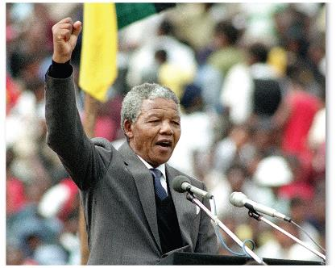
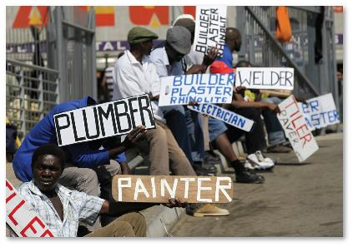
Territory and Politics
Apartheid
  South Africa
  Nelson Mandela
  Geographic separation of races
  Pass laws
  Homelands

Slide 26
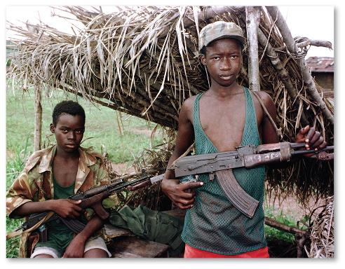
Territory and Politics (cont.)
Civil wars and internal conflicts
  Rwanda and Burundi
    genocide
  Liberia and Sierra Leone
    child soldiers
  Somalia and Ethiopia
    failed state

Slide 27

Territory and Politics (cont.)
Peacekeeping
  U.N. presence
  ECOMOG

Slide 28
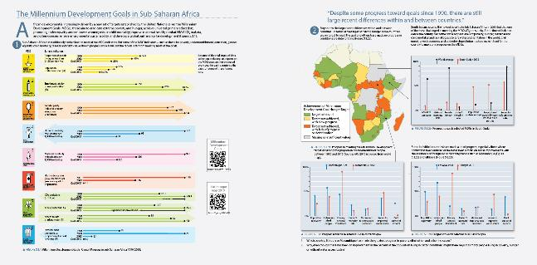
Visualizing Geography
Millennium Development Goals
  eradicate poverty
  universal primary education
  promote gender equality
  combat disease
  ensure environmental sustainability

Slide 29
Culture and Populations/Ethnicity
Large, diverse region
Traditional religions
Hundreds of different ethnic groups
Tribe
Largest ethnic groups associated with dominate languages

Slide 30
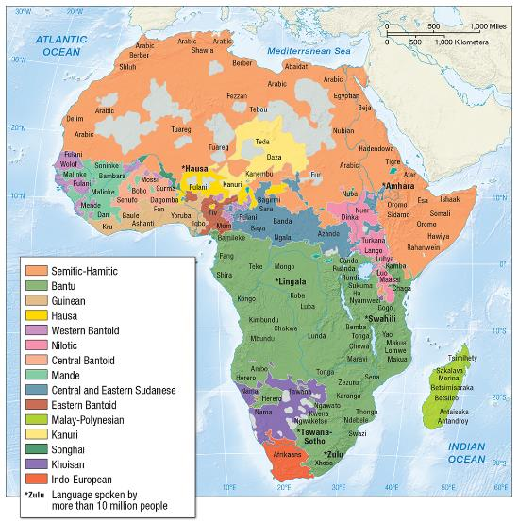
Religion/Language
Animist (worship of nature)
Spread of Christianity and Islam dominate
More than 1,000 living languages
Lingua franca

Slide 31
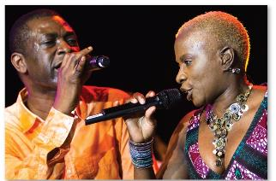

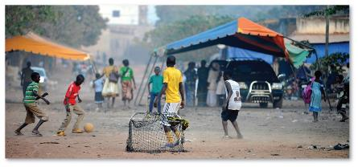
Cultural Practices, Social Differences, and Identity
Kinship
Land
Music, art, and film
  musical traditions
  griots
  pop music
  African art
  Nollywood
Sport
  soccer
  distance runners

Slide 32
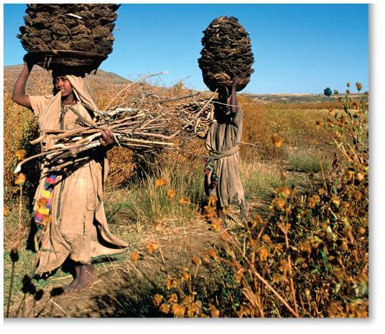
Cultural Practices, Social Differences, and Identity (cont.)
Changing roles of women
  feminization of poverty
  patriarchy
  property rights
  programs that recognize women’s contributions

Slide 33
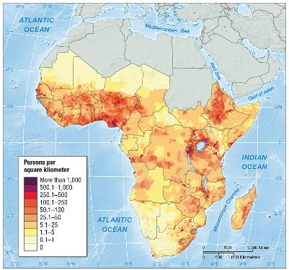
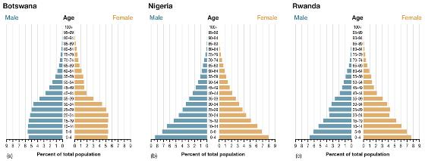
Demography and Urbanization
Annual growth rate of 2.7%
  children valued
  security for elderly
  ready source of labor
  symbols of status
Fertility
  conditions for women
    age of marriage
    education
    urban vs. rural

Slide 34
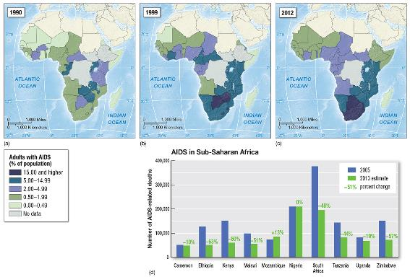
Demography and Urbanization (cont.)
Health concerns
  HIV/AIDS
    rates highest in Southern/Eastern Africa
    women more affected
    role of poverty
    low health-care
    budgets

Slide 35
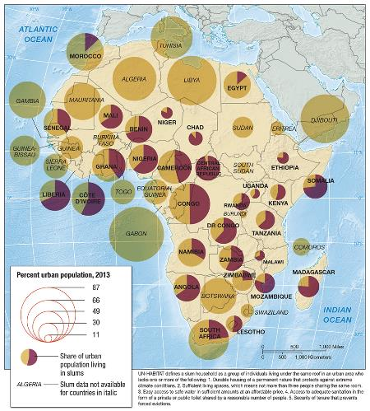
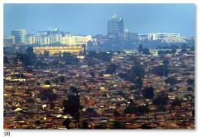
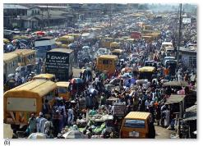
Demography and Urbanization (cont.)
African cities
  rural-to-urban migration
  nearly 40% of
  population urban
  Urban bias

Slide 36
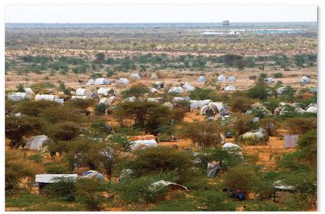
Demography and Urbanization (cont.)
African diaspora
  Legacy of slavery
  Post-colonial
  Brain drain
Migration within Africa
  Search for employment
  Leaving conflict areas
Refugees/IDPs
  15.1 million in the region

Slide 37
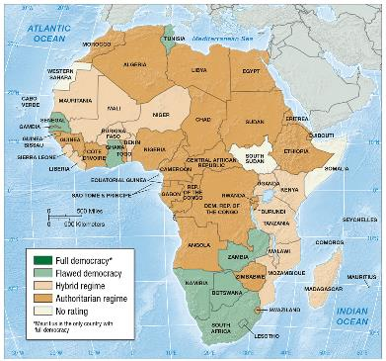
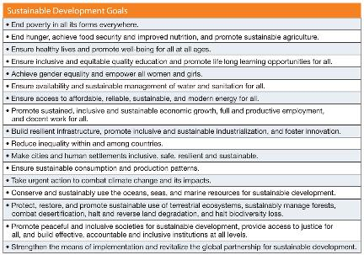
Future Geographies
Sustaining representative and affective government
  transparency and greater participation
Economic opportunities
  ensuring food security
  debt forgiveness
  fostering a middle class
Food, water, health and energy for all

